Slide 1

算法分析与设计
Analysis and Design of Algorithms
山东大学 · 软件学院
2017年

Slide 2
23 Minimum Spanning Tree
The Minimum Spanning Tree Problem
Kruskal’s Algorithm
Prim’s Algorithm

Slide 3
Tree and Its Properties
Tree is an acyclic, connected graph.
A tree of |V| vertices has |V|-1 edges.
There exists a unique path between any two vertices of a tree.
Adding any edge to a tree creates a unique cycle. Breaking any edge on this cycle restores a tree.
Deleting any edge on a tree increases the number of connected components by 1.

Slide 4
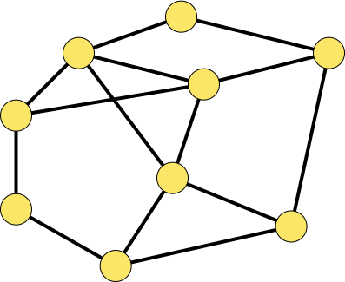
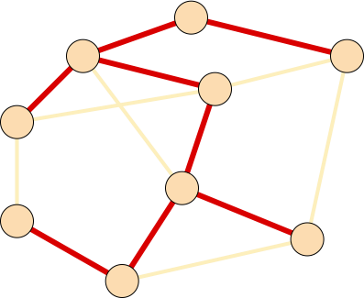
Minimum Spanning Tree Problem
The Problem:
Input: A connected, weighted, undirected graph G = (V, E; W).
Output: A minimum spanning tree T for G.
1
3
1
3
6
3
3
6
6
6
9
1
9
7
5
7
1
5
8
8
3
3
2
2
7
4
7
4

Slide 5
Basic Idea
Grows the minimum spanning tree one edge at a time.
What’s the foundation?: An edge set A that is a subset of some minimum spanning tree T;
Which edge?: An edge (u, v) satisfying that A∪{(u, v)} is also a subset of some minimum spanning tree T’.
In other words, maintains the following loop invariant:
Prior to each iteration, A is a subset of some minimum spanning tree.
The edge (u, v) is called a safe edge for A if A∪{(u, v)} is also a subset of of a minimum spanning tree, that is,
(u, v) can be safely added to A without violating the above invariant

Slide 6
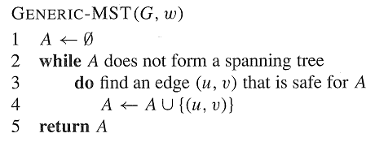
A Generic Algorithm
Kruskal’s Algorithm
Prim’s Algorithm
Kruskal’s and Prim’s algorithms are implementations of the generic algorithm on how to maintain A and find the safe edge (u, v) for A.

Slide 7
How to find Safe Edges for A Related Notions
A cut (X, Y) of a graph G = (V, E) is a partition of the vertex set V into two sets X and Y = V \ X.
An edge (u, v)∈ E is said to cross the cut (X, Y) if u ∈ X and v ∈ Y.
A cut (X, Y) respects a set A of edges if no edge in A crosses the cut.
An edge is a light edge crossing a cut if its weight is the minimum of any edge crossing the cut.
8
7
b
c
d
9
4
2
X↑
a
11
i
14
e
↑ X
4
7
6
8
10
Y↓
h
g
f
↓ Y
1
2

Slide 8
How to find Safe Edges for A
Theorem 23.1 Let G = (V, E) be a connected, undirected graph with real-valued weight function w defined on E. Let A be a subset of E that is included in some minimum spanning tree for G, let (X, Y) be any cut of G that respects A, and let (u, v) be a light edge crossing (X, Y). Then, edge (u, v) is safe for A.
8
7
y
u
v
9
X↑
x
p
9
w
↑ X
8
8
Y↓
s
q
z
↓ Y

Slide 9
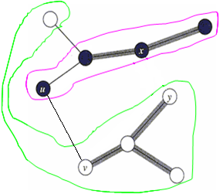
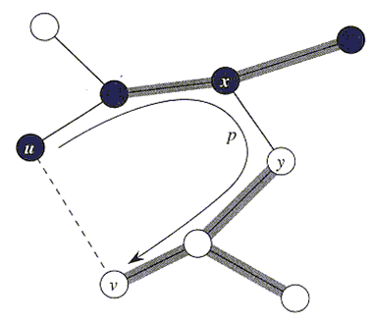
Proof of Theorem 23.1
Proof: Let T be a MST including A. It suffices to consider two cases:
Case 1: T contains the light edge (u, v). We are done;
Case 2: T does not contain the light edge (u, v). In order to show that (u, v) is a safe edge for A, we shall construct another MST T’ that includes A∪{(u, v)}.
The edge (u, v) forms a cycle with the edges on the path p from u to v in T. Since u and v are on opposite sides of the cut (X,Y), there is at least one edge in T on the path p that also crosses the cut. Let (x, y) be any such edge. Since (x, y) is on the unique path from u to v in T, removing (x, y) breaks T into two components. Adding (u, v) reconnects them to form a new spanning tree T’ = T-{(x, y)} ∪{(u, v)}.
It is easy to show that T’ is a minimum spanning tree.
It also is easy to show that T’ includes A∪{(u, v)}.
X
Y
X
Y

Slide 10
A Corollary
Corollary 23.2 Let G = (V, E) be a connected, undirected graph with real-valued weight function w defined on E. Let A be a subset of E that is included in some minimum spanning tree for G, and let C = (V_{C}, E_{C}) be a connected component in the forest G_{A} = (V, A). If (u, v) is a light edge connecting C to some other component in G_{A}, then (u, v) is safe for A.
Proof: The cut (V_{C}, V\V_{C}) respects A, and (u, v) is a light edge for this cut. Therefore, (u, v) is safe for A.
7
7
y
u
v
9
x
p
9
w
9
9
10
8
Note: Kruskal and Prim’s algorithms are based on the corollary.
s
q
9
z

Slide 11
Idea of the Kruskal
Initialize the forest, each vertex as a tree, A← Φ.
Find the least weight edge (u, v) that connects any two trees in the forest.
Add (u, v) to A and union the two tree into one tree, number of trees in the forest decreases 1.
Repeat step 2 and 3 until A forms a spanning tree.

Slide 12
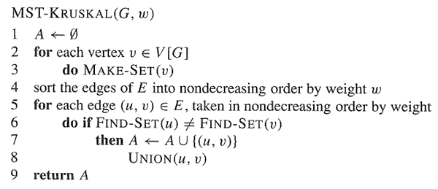
Kruskal’s Algorithm

Slide 13

9
a
1
b
3
d
4
c
(a, d):1 (h, i):1 (c, e):1 (f, h):2 (g, h):2
(b, c):3 (b, f):3 (b, e):4 (c, d):5 (f, g):5
(e, i):6 (d, g):8 (a, b):9 (c, f):12
5
e
1
3
12
8
6
f
5
i
2
g
2
1
h
9
a
1
b
3
d
4
c
5
(a, d):1 (h, i):1 (c, e):1 (f, h):2 (g, h):2
(b, c):3 (b, f):3 (b, e):4 (c, d):5 (f, g):5
(e, i):6 (d, g):8 (a, b):9 (c, f):12
e
1
3
12
8
6
f
5
i
2
g
2
1
h

Slide 14
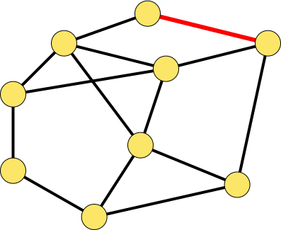
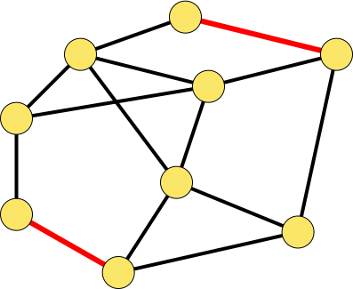
9
a
1
b
3
d
4
c
5
(a, d):1 (h, i):1 (c, e):1 (f, h):2 (g, h):2
(b, c):3 (b, f):3 (b, e):4 (c, d):5 (f, g):5
(e, i):6 (d, g):8 (a, b):9 (c, f):12
e
1
3
12
8
6
f
5
i
2
g
2
1
h
9
a
1
b
3
d
(a, d):1 (h, i):1 (c, e):1 (f, h):2 (g, h):2
(b, c):3 (b, f):3 (b, e):4 (c, d):5 (f, g):5
(e, i):6 (d, g):8 (a, b):9 (c, f):12
4
c
5
e
1
3
12
8
6
f
5
i
2
g
2
1
h

Slide 15
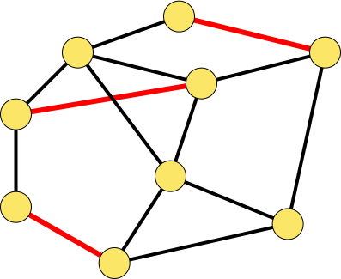
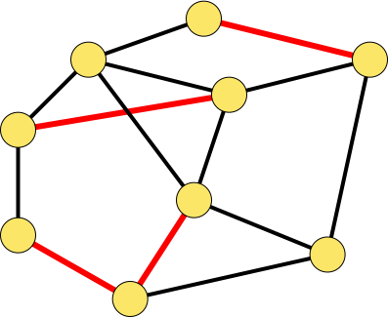
9
a
1
b
3
d
(a, d):1 (h, i):1 (c, e):1 (f, h):2 (g, h):2
(b, c):3 (b, f):3 (b, e):4 (c, d):5 (f, g):5
(e, i):6 (d, g):8 (a, b):9 (c, f):12
4
c
5
e
1
3
12
8
6
f
5
i
2
g
2
1
h
9
a
1
b
3
d
(a, d):1 (h, i):1 (c, e):1 (f, h):2 (g, h):2
(b, c):3 (b, f):3 (b, e):4 (c, d):5 (f, g):5
(e, i):6 (d, g):8 (a, b):9 (c, f):12
4
c
5
e
1
3
12
8
6
f
5
i
2
g
2
1
h

Slide 16
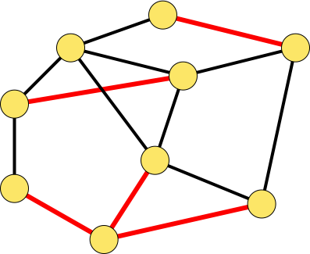

9
a
1
b
3
d
(a, d):1 (h, i):1 (c, e):1 (f, h):2 (g, h):2
(b, c):3 (b, f):3 (b, e):4 (c, d):5 (f, g):5
(e, i):6 (d, g):8 (a, b):9 (c, f):12
4
c
5
e
1
3
12
8
6
f
5
i
2
g
2
1
h
9
a
1
b
(a, d):1 (h, i):1 (c, e):1 (f, h):2 (g, h):2
(b, c):3 (b, f):3 (b, e):4 (c, d):5 (f, g):5
(e, i):6 (d, g):8 (a, b):9 (c, f):12
3
d
4
c
5
e
1
3
12
8
6
f
5
i
2
g
2
1
h

Slide 17
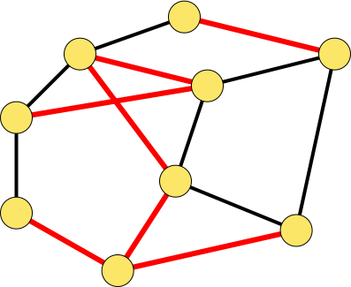
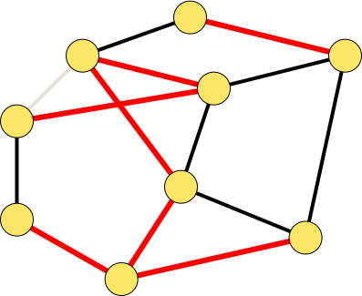
9
a
1
b
d
(a, d):1 (h, i):1 (c, e):1 (f, h):2 (g, h):2
(b, c):3 (b, f):3 (b, e):4 (c, d):5 (f, g):5
(e, i):6 (d, g):8 (a, b):9 (c, f):12
3
4
c
5
e
1
3
12
8
6
f
5
i
2
g
2
1
h
9
a
1
b
d
(a, d):1 (h, i):1 (c, e):1 (f, h):2 (g, h):2
(b, c):3 (b, f):3 (b, e):4 (c, d):5 (f, g):5
(e, i):6 (d, g):8 (a, b):9 (c, f):12
3
4
c
5
e
1
3
12
8
6
f
5
i
2
g
2
1
h

Slide 18
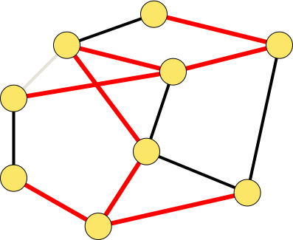
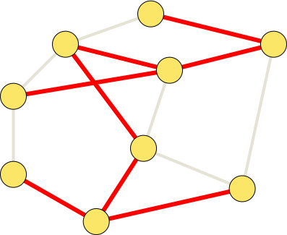
9
a
1
b
3
d
(a, d):1 (h, i):1 (c, e):1 (f, h):2 (g, h):2
(b, c):3 (b, f):3 (b, e):4 (c, d):5 (f, g):5
(e, i):6 (d, g):8 (a, b):9 (c, f):12
4
c
5
e
1
3
12
8
6
f
5
i
2
g
2
1
h
9
a
1
(a, d):1 (h, i):1 (c, e):1 (f, h):2 (g, h):2
(b, c):3 (b, f):3 (b, e):4 (c, d):5 (f, g):5
(e, i):6 (d, g):8 (a, b):9 (c, f):12
b
3
d
4
c
5
e
1
3
12
8
6
f
5
i
2
g
2
1
h

Slide 19
Idea of the Prim
Start from a vertex r, add r to a vertex set U which is initialized to empty.
Find the least weight edge (u,v), u∈U, v∈V-U, add (u,v) to A, and add v to U.
A is the loop invariant.
Repeat 2 until A forms a spanning tree or U = V.

Slide 20
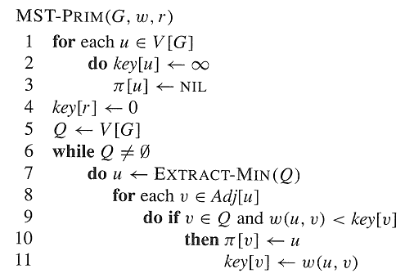
Prim’s Algorithm

Slide 21
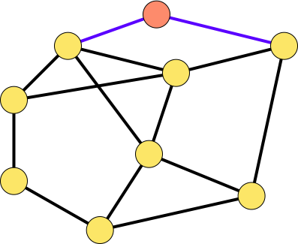
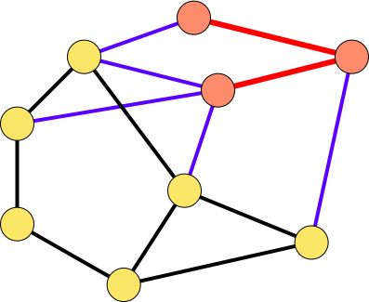
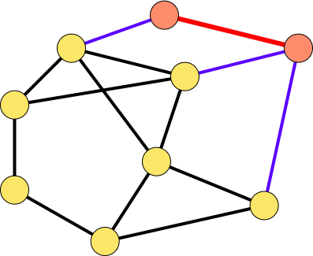
9
r
1
9
r
1
b
3
d
b
3
d
4
c
5
4
c
5
e
1
e
1
3
12
8
3
12
8
6
6
f
5
f
5
i
i
2
g
2
g
1
2
h
1
h
2
9
r
1
9
r
1
b
3
d
b
3
d
4
c
5
4
c
5
e
1
e
1
3
12
8
3
12
8
6
f
6
f
5
5
i
2
g
i
2
2
2
g
1
h
1
h

Slide 22
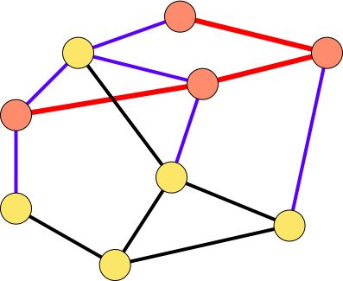
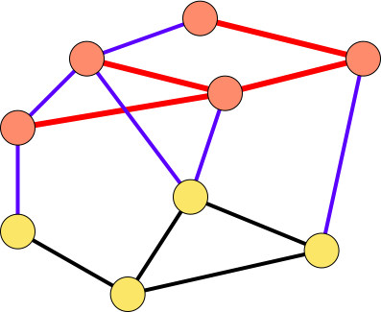
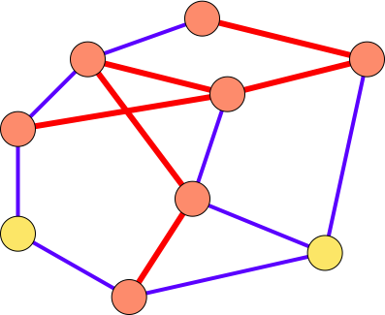
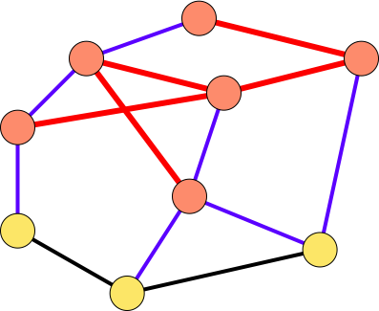
r
r
9
a
1
9
1
b
d
b
3
d
3
4
4
c
c
5
5
e
e
1
1
12
3
12
8
3
8
6
f
6
f
5
5
i
i
2
2
g
2
g
2
1
1
h
h
9
r
1
9
r
1
b
3
d
b
3
d
4
c
5
4
c
5
e
1
e
1
3
12
8
3
12
8
6
f
6
f
5
5
i
2
i
2
g
2
g
2
1
h
1
h

Slide 23
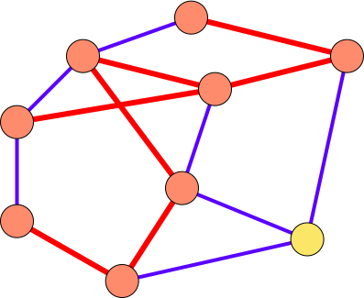
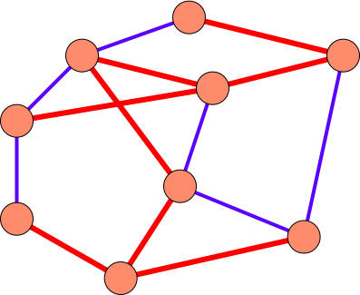
9
r
1
9
r
1
b
3
d
b
3
d
4
c
5
4
c
5
e
1
e
1
3
12
8
3
12
8
6
f
6
f
5
5
i
2
i
2
2
g
2
g
1
h
1
h

